Slide 1
Introduction to Big Data
& Data Science
20-Aug-2018
Pune
Pratik Shirbhate
pratikshirbhate@gmail.com
+91 7588809138

Slide 2

Big Data Every Where!
Lots of data is being collected
and warehoused
  Web data, e-commerce
  purchases at department/
  grocery stores
  Bank/Credit Card
  transactions
  Social Network

Slide 3
How much data?
Google processes 20 PB a day
Facebook handles 40 billion photos from its user base has 2.5 PB of user data + 15 TB/day
eBay has 6.5 PB of user data + 50 TB/day
Walmart handles more than 1 million customer transactions every hour-2.5 petabytes of data
Falcon Credit Card Fraud Detection System protects 2.1 billion active accounts world-wide
"Big Data are high-volume, high-velocity, and/or high-variety information assets that require new forms of processing to enable enhanced decision making, insight discovery and process optimization” (Gartner 2012)
Bottom line: Any data that exceeds our current capability of processing can be regarded as “big”

Slide 4
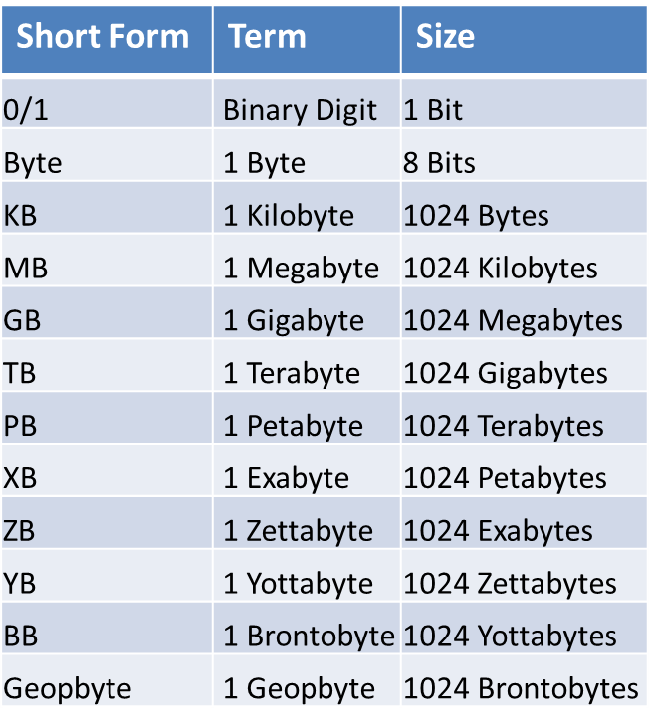
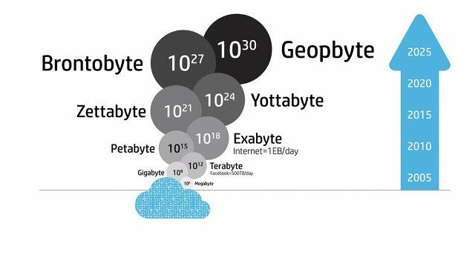

Slide 5
Lifecycle of Data: 4 “A”s
Scattered
Data
Aggregation
Integrated
Data
Acquisition
Analysis
Log data
Knowledge
Application

Slide 6
Computational View of Big Data
Data Visualization
Data Access
Data Analysis
Data Understanding
Data Integration
Formatting, Cleaning
Storage
Data

Slide 7
Big Data & Related Topics/Courses
Human-Computer Interaction
Data Visualization
Databases
Information Retrieval
Machine Learning
Data Access
Data Analysis
Data Mining
Computer Vision
Speech Recognition
Data Understanding
Data Integration
Natural Language Processing
Data Warehousing
Formatting, Cleaning
Signal Processing
Many Applications!
Storage
Data
Information Theory

Slide 8
Type of Data
Relational Data (Tables/Transaction/Legacy Data)
Text Data (Web)
Semi-structured Data (XML)
Graph Data
  Social Network, Semantic Web (RDF), …
Streaming Data
  You can only scan the data once

Slide 9
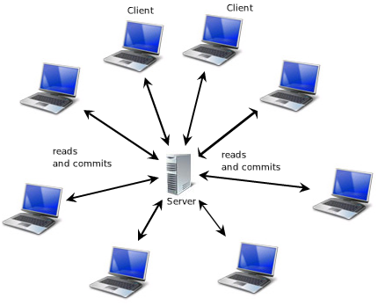
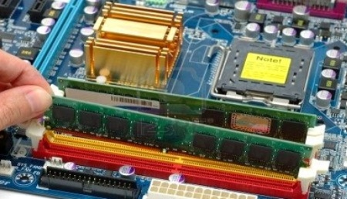
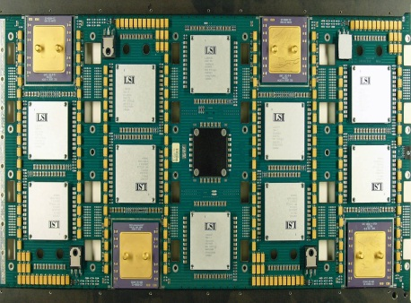
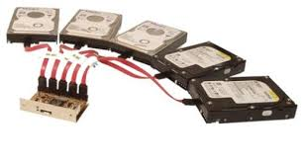
Client Server Architecture
Solution :
RAM ++
Processors ++
HDD ++
Problem :
Processing limitation
Storage Limitation
H/W Failure

Slide 10
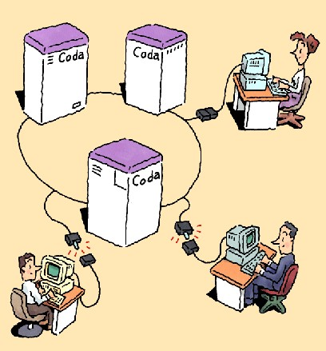
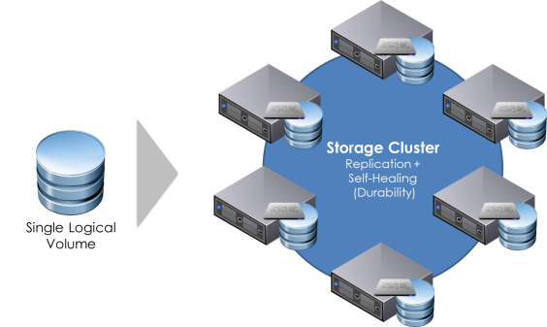
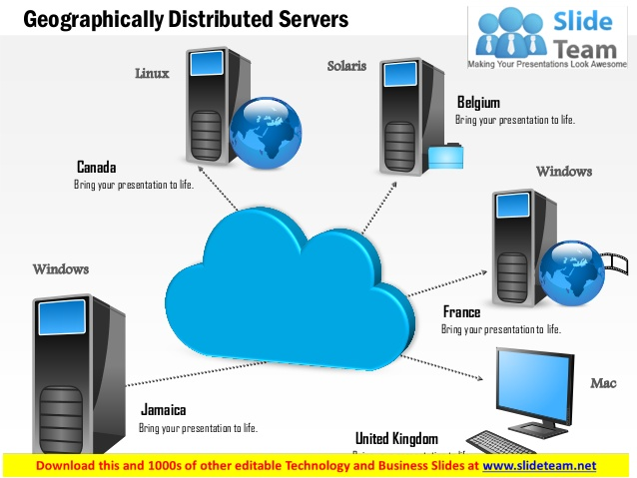
Get it Distributed … Hadoop !!!
Hadoop is an open-source software framework for storing and processing big data in a distributed fashion on large clusters of commodity hardware.
Advantage: massive data storage and faster processing

Slide 11
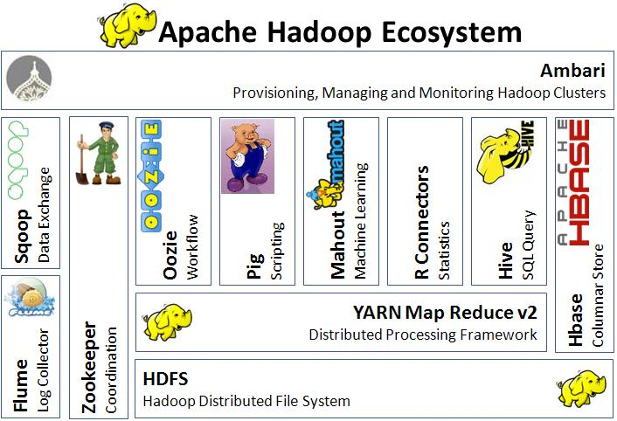
Eco System : Bigger Picture

Slide 12
Why hadoop, Not RDBMS?
For huge data, RDBMS seek time is more.
RDBMS works fine on smaller data sets
RDBMS are good for point queries or updates. Data is indexed so retrieval of small dataset is faster
RDBS are good for multiple inserts and updates
RDBMS stores data in structured form ( db rows and cols, XML)
Hadoop uses Map Reduces to read whole data in batch. So Seek time is less.
Works best of bigger data sets
Map Reduce suits application where data is written once and read many times.
Hadoop is not used for inserting data, Its used for reading
Map Reduce works best on Unstructured form (blogs, email, chat)

Slide 13





















Who uses Hadoop

Slide 14
What is Data Science?
Data Driven Decision Making
Building business strategies based on data analysis
Making use of past experience (data) to make/ build future strategies
Data Science is not Data Analytics/Data Visualization/Big Data Engineering
Fusion of above along with Database management, predictive modelling, machine learning, coding and reporting

Slide 15
What is Data Mining?
Discovery of useful, possibly unexpected, patterns in data
Non-trivial extraction of implicit, previously unknown and potentially useful information from data
Exploration & analysis, by automatic or
semi-automatic means, of large quantities of data in order to discover meaningful patterns

Slide 16
Applications of Data Science
Recommender Systems
  Youtube, Netflix, Kindle, Facebook feed, flipkart/amazon
  Identifying potential customers for AUDI/Credit cards
  Promotional offers for credit card holders: Customer credit card usage is analyzed
Image Recognition
  Amazon App
Speech recognition
  Google speech to text/ apple macbook- siri
Fraud transaction identification
  Bank loan defaulters
  Medical Claims denial

Slide 17
Data Mining Tasks
Classification
Clustering
Recommender Systems:
  Identifying potential customers for AUDI/Credit cards
  Promotional offers for credit card holders: Customer credit card usage is analyzed
Association Rule Discovery
Sequential Pattern Discovery
Regression
Deviation Detection

Slide 18
What is Machine Learning
Machine learning is an application of artificial intelligence (AI) that provides systems the ability to automatically learn and improve from experience without being explicitly programmed
Machine learning focuses on the development of computer programs that can access data and use it learn for themselves

Slide 19
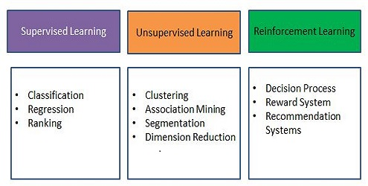
Types of Machine Learning

Slide 20
Machine Learning Approach
Given a collection of records (training set )
  Each record contains a set of attributes/features, one of the attributes is the class/output value.
Find a model for class/output attribute as a function of the values of other attributes.
Goal: previously unseen records should be assigned a class/output value as accurately as possible.
  A test set is used to determine the accuracy of the model. Usually, the given data set is divided into training and test sets, with training set used to build the model and test set used to validate it.

Slide 21
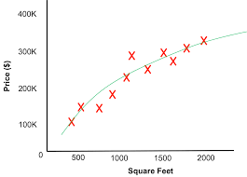
Regression

Slide 22
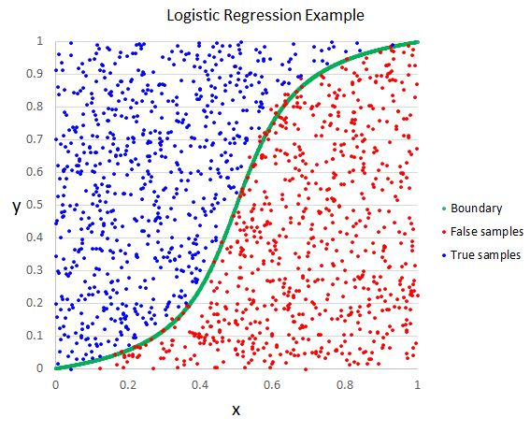
Classification
Salary | Age | Buy Car (Yes/No)
15000 | 19 | No
25000 | 33 | Yes
55000 | 60 | No
65000 | 45 | Yes
45000 | 25 | ????
39000 | 42 | ????

Slide 23
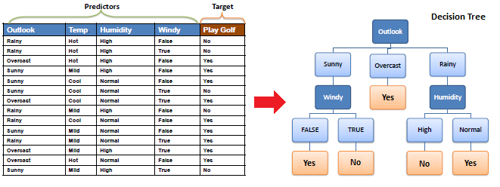
Classification- Decision Tree

Slide 24
Clustering
income
education
age

Slide 25
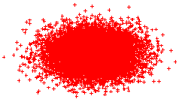


K-Means Clustering

Slide 26
Association Rule Mining
transaction
id
customer
id
products
bought
sales
records:
market-basket
data
Trend: Products p5, p8 often bough together
Trend: Customer 12 likes product p9

Slide 27
Association Rule Applications
Marketing and Sales Promotion:
  Let the rule discovered be
  {Beer/Cold Drinks, … } --> {Potato Chips}
  Potato Chips as consequent => Can be used to determine what should be done to boost its sales.
  Beer/Cold Drink in the antecedent => can be used to see which products would be affected if the store discontinues selling bagels.
  Beer/Cold Drink in antecedent and Potato chips in consequent => Can be used to see what products should be sold with Bagels to promote sale of Potato chips!
Supermarket shelf management.
Inventory Management
Notes:
If a customer buys diaper and milk, then he is very likely to buy beer.
So, don’t be surprised if you find six-packs stacked next to diapers!

Slide 28
Other Types of Mining
Text mining: application of data mining to textual documents
  cluster Web pages to find related pages
  cluster pages a user has visited to organize their visit history
  classify Web pages automatically into a Web directory
Graph Mining:
  Deal with graph data

Slide 29
Questions??????????

Slide 30
Why should I make career in Big Data/Data Science?
Who can enter into Big Data/Data Science Field?
What should I do to enter into Big Data/Data Science field?
What are the tools and technologies do I need to learn?
Where should I learn?
How much time should I invest in order to become good fit to Big Data Engineer/ Data Scientist role?

Slide 31
Why should I make career in Big Data/Data Science?
Soaring Demand for Analytics Professionals: US will face a shortage of about 190,000 data scientists and 1.5 million analysts who can understand and make decisions using Big Data by 2020
Salary Aspects: Average salary in India 10 LPA
Big Data Analytics: A Top Priority in a lot of Organizations
Adoption of Big Data Analytics is Growing
Analytics: A Key Factor in Decision Making
The Rise of Unstructured and Semi structured Data Analytics
Big Data Analytics is Used Everywhere!

Slide 32
Statistics

Slide 33
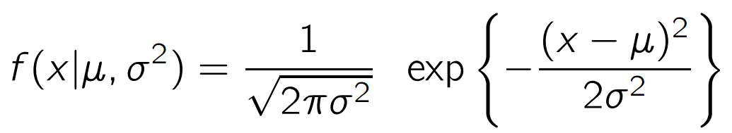
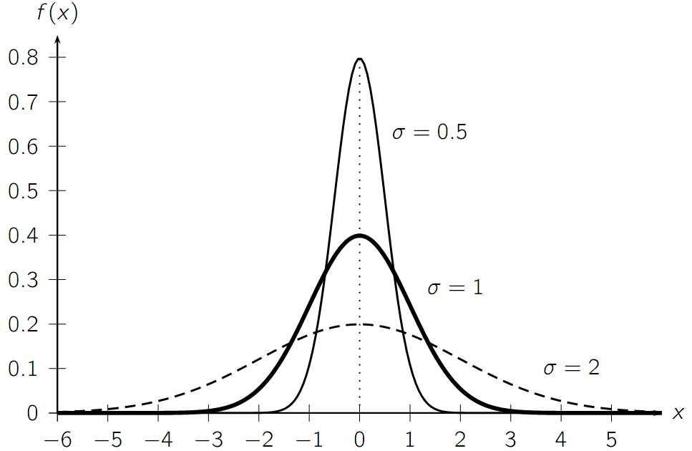
Univariate Normal Distribution

Slide 34
Who can enter into Big Data/Data Science Field?
People with rich research experience in quantitative fields such as Statistics, Physics, Mathematics or Applied Math
People from software engineering background. This can be former software engineers who want to switch the gear.
People who have a strong Machine Learning foundation.
People who work in consulting, banking, healthcare or have other business background
Anyone who can prove himself / herself to be good: this can possibly be demonstrated by personal data projects or active involvement in Kaggle competitions

Slide 35
What should I do to enter into Big Data/Data Science field?
You won’t be able to grab an opportunity until and unless you have knowledge about it. In order to build a career in data science skills you need to learn:
Applied mathematics/statistics
Database knowledge: SQL, Languages: Python/R/SPSS/SAS, Linux/Shell scripting
Big Data Technologies and Distributed computing: Hadoop, Spark, Hive, Unstructured data analysis (Pig)
Data Visualization tools: MS Power BI, Tableau,Qlikview
Machine Learning (R/Python)- Supervised/Unsupervised/Deep Learning/ Natural Language processing/ Neural Networks/Recommender Systems

Slide 36
What are the tools and technologies do I need to learn?
Applied mathematics/statistics
Languages: SQL, Python/R/SPSS/SAS, Linux/Shell scripting
Big Data Technologies: Hadoop, Spark,Hive,Pig
Data Visualization tools: MS Power BI, Tableau, R-ggplot, Python-Seaborn/Bokeh
Machine Learning- Supervised/Unsupervised/Deep Learning/ Natural Language processing/ Neural Networks/Recommender Systems

Slide 37
Where should I learn? How much time should I need to invest?
Udemy, Simplilearn, Udacity, Datacamp, Edureka, Coursera
4 hours/Day- for 1 Year
The most comprehensive Data Science learning plan for 2018- Analytics Vidhya
https://www.analyticsvidhya.com/blog/2017/01/the-most-comprehensive-data-science-learning-plan-for-2017/

Slide 38
Thank you

